Slide 1
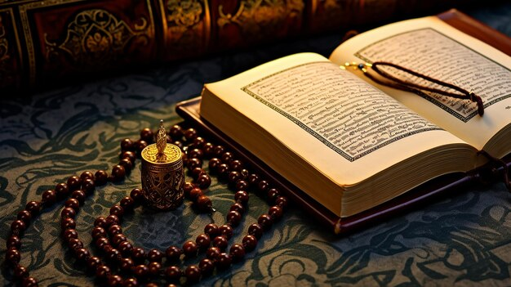
🕌 Complete Salah Supplications
بِسْمِ اللَّهِ الرَّحْمَـٰنِ الرَّحِيمِ

Slide 2

1.
2.
3.
Opening Supplication (Duʿāʾ al-Istiftā-ḥ)
Sūrat al-Fātiḥah
Rukūʿ (Bowing)
4.
5.
6.
Rising from Rukūʿ
Sujūd (Prostration)
Sitting Between the Two Sujoods
7.
Tashahhud (by ʿAbdullāh ibn Masʿūd RA)

Slide 3
1. Opening Supplication (Duʿāʾ al-Istiftāḥ)
سُبْحَانَكَ اللّهُمَّ وَبِحَمْدِكَ، وَتَبَارَكَ اسْمُكَ، وَتَعَالَى جَدُّكَ، وَلَا إِلٰهَ غَيْرُكَ
Transliteration: Subḥānaka Allāhumma wa bi-ḥamdika, wa tabāraka ismuka, wa taʿālā jadduka, wa lā ilāha ghayruka Translation: Glory be to You, O Allah, and praise be to You. Blessed is Your Name, exalted is Your Majesty, and there is no deity besides You.

Slide 4
2. Sūrat al-Fātiḥah
بِسْمِ اللَّهِ الرَّحْمَـٰنِ الرَّحِيمِ الْـحَمْدُ لِلَّهِ رَبِّ الْعَالَمِينَ الرَّحْمَـٰنِ الرَّحِيمِ مَالِكِ يَوْمِ الدِّينِ إِيَّاكَ نَعْبُدُ وَإِيَّاكَ نَسْتَعِينُ اهْدِنَا الصِّرَاطَ الْمُسْتَقِيمَ صِرَاطَ الَّذِينَ أَنْعَمْتَ عَلَيْهِمْ غَيْرِ الْمَغْضُوبِ عَلَيْهِمْ وَلَا الضَّالِّينَ
Transliteration: Bismillāhir-raḥmānir-raḥīm Al-ḥamdu lillāhi rabbil-ʿālamīn Ar-raḥmānir-raḥīm Māliki yawmid-dīn Iyyāka naʿbudu wa iyyāka nastaʿīn Ihdinaṣ-ṣirāṭal-mustaqīm Ṣirāṭal-ladhīna anʿamta ʿalayhim ghayril-maghḍūbi ʿalayhim wa laḍ-ḍāllīn Translation: In the name of Allah, the Most Gracious, the Most Merciful. All praise is for Allah, Lord of the worlds. The Most Gracious, the Most Merciful. Master of the Day of Judgment. You alone we worship, and You alone we ask for help. Guide us on the straight path. The path of those whom You have blessed; not of those who earned Your anger, nor of those who went astray.

Slide 5
3. Rukūʿ (Bowing)
سُبْحَانَ رَبِّيَ الْعَظِيمِ
Transliteration: Subḥāna rabbīyal-ʿaẓīm Translation: “Glory be to my Lord, the Most Great.”

Slide 6
4. Rising from Rukūʿ
سَمِعَ اللّهُ لِمَنْ حَمِدَهُ
Transliteration: Samiʿa Allāhu liman ḥamidah Translation: “Allah hears the one who praises Him.”
رَبَّنَا وَلَكَ الْحَمْدُ
Transliteration: Rabbana wa laka al-ḥamd
Translation: “Our Lord, and to You belongs all praise.”
Extended Sunnah: رَبَّنَا وَلَكَ الْحَمْدُ، حَمْدًا كَثِيرًا طَيِّبًا مُبَارَكًا فِيهِ
Transliteration: Rabbana wa laka al-ḥamd, ḥamdan kathīran ṭayyiban mubārakan fīh
Translation: “Our Lord, and to You belongs all praise — abundant, pure, and blessed praise.”

Slide 7
5. Sujūd (Prostration)
سُبْحَانَ رَبِّيَ الأَعْلَى
Transliteration: Subḥāna rabbīyal-aʿlā Translation: Glory be to my Lord, the Most High.

Slide 8
6. Sitting Between the Two Sujoods
رَبِّ اغْفِرْ لِي، رَبِّ اغْفِرْ لِي
Transliteration: Rabbighfir lī, Rabbighfir lī Translation: “My Lord, forgive me. My Lord, forgive me.”

Slide 9
7. Tashahhud (by ʿAbdullāh ibn Masʿūd RA)
اَلتَّحِيَّاتُ لِلَّهِ، وَالصَّلَوَاتُ وَالطَّيِّبَاتُ، اَلسَّلَامُ عَلَيْكَ أَيُّهَا النَّبِيُّ وَرَحْمَةُ اللَّهِ وَبَرَكَاتُهُ، اَلسَّلَامُ عَلَيْنَا وَعَلَى عِبَادِ اللَّهِ الصَّالِحِينَ، أَشْهَدُ أَنْ لَا إِلٰهَ إِلَّا اللَّهُ، وَأَشْهَدُ أَنَّ مُحَمَّدًا عَبْدُهُ وَرَسُولُهُ
Transliteration: At-taḥiyyātu lillāh, waṣ-ṣalawātu waṭ-ṭayyibāt. As-salāmu ʿalayka ayyuhan-nabiyyu wa raḥmatullāhi wa barakātuh. As-salāmu ʿalaynā wa ʿalā ʿibādillāhiṣ-ṣāliḥīn. Ashhadu an lā ilāha illallāh, wa ashhadu anna Muḥammadan ʿabduhū wa rasūluh. Translation: “All greetings, prayers, and pure words are for Allah. Peace be upon you, O Prophet, and the mercy of Allah and His blessings. Peace be upon us and upon the righteous servants of Allah. I bear witness that there is no deity worthy of worship except Allah, and I bear witness that Muḥammad is His servant and Messenger.”

Slide 10
Thank You!
جَزَاكَ ٱللَّٰهُ خَيْرًا Jazākallāhu Khayran – "May Allah reward you with goodness"

